Slide 1
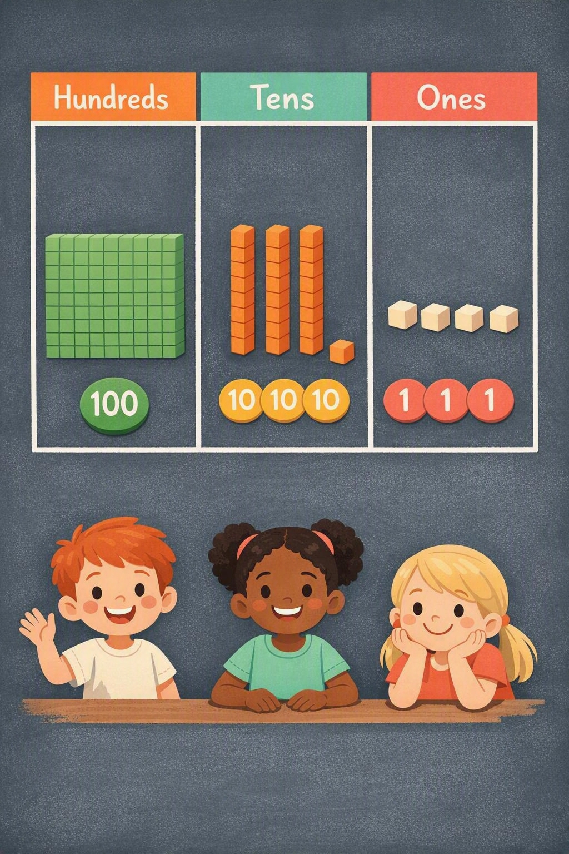
Multiplication and division
Year 4 — HTO × O, consolidating and extending to 3-digit numbers
Year 4 | Concrete | Pictorial | Abstract | Using and applying
Crossing one boundary 134 × 3 | Build 1 hundred, 3 tens and 4 ones with base-ten apparatus, then make three sets on the place-value mat. Exchange 10 ones for 1 ten. | Grid method × | 100 | 30 | 4 3 | 300 | 90 | 12 300 + 90 + 12 = 402 Leading to the expanded vertical method. | Expanded 12 (3 × 4) 90 (3 × 30) 300 (3 × 100) 402 Compact: 134 × 3 = 402 | In one week, 142 people visited the aquarium each day. How many visits were there altogether? Use the digits 2, 4, 6 and 8 to make a multiplication O × HTO. Which product is largest, and which is smallest?
Crossing two boundaries 268 × 4 | Build 2 hundreds, 6 tens and 8 ones, four times over. Exchange twice: 10 ones for 1 ten, then 10 tens for 1 hundred. | Grid method × | 200 | 60 | 8 4 | 800 | 240 | 32 800 + 240 + 32 = 1072 Partitioning keeps every step visible. | Expanded 32 (4 × 8) 240 (4 × 60) 800 (4 × 200) 1072 Compact: 268 × 4 = 1072 | Our class raised £118 every day for 4 days, then shared the money equally between 2 charities. How much did each charity receive? O × HTO = 960. How many different ways can you solve this?

