Slide 1
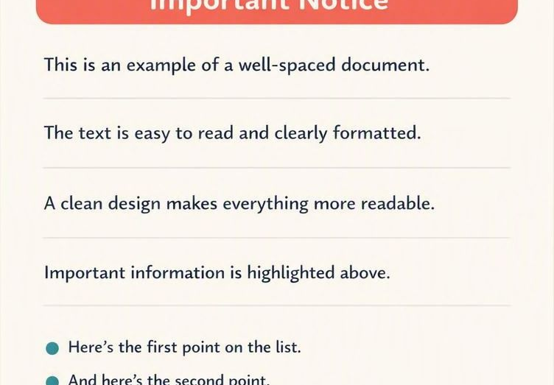

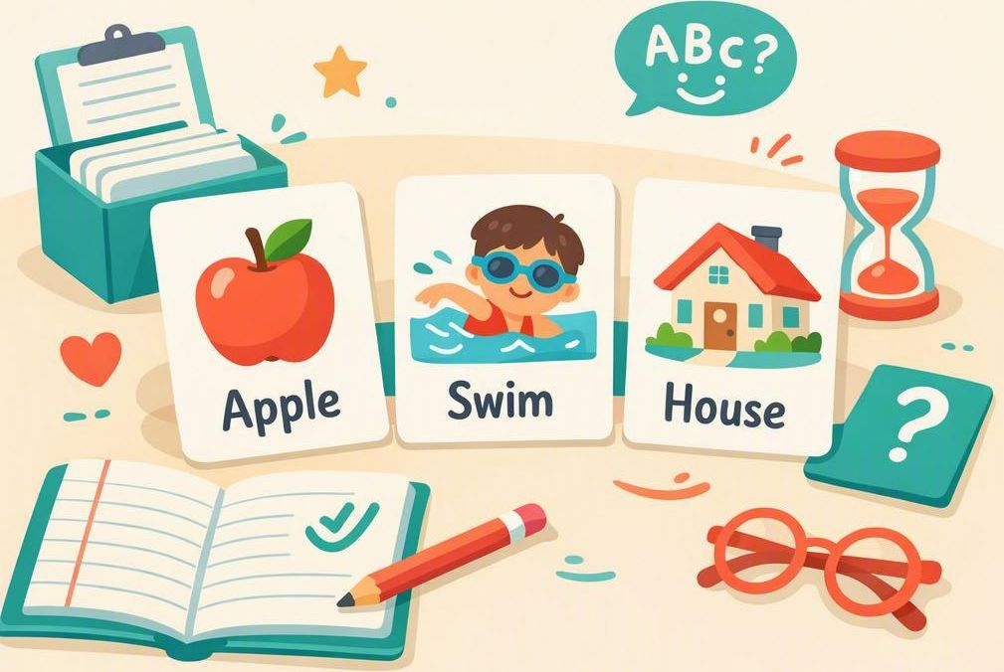

Reading & Spelling Support
Decoding takes real effort, so reading rate, accuracy and comprehension can all suffer.
Practical ways to help learners with dyslexia feel confident with words
1
2
3
4
Ease the text load
Add another sense
Teach words twice
Give plenty of time
Space out text, keep it short, and use a clear sans-serif font at a generous size.
Let students listen while they follow along — audiobooks and read-aloud tools help.
Introduce new words beforehand, revisit them after, and practise them often.
Allow processing time and never ask a student to read aloud on the spot.
Small changes make a big difference — confidence grows when reading feels possible.

